Slide 1
Mexican Hunting Taco
(I was forced :c)

Slide 2
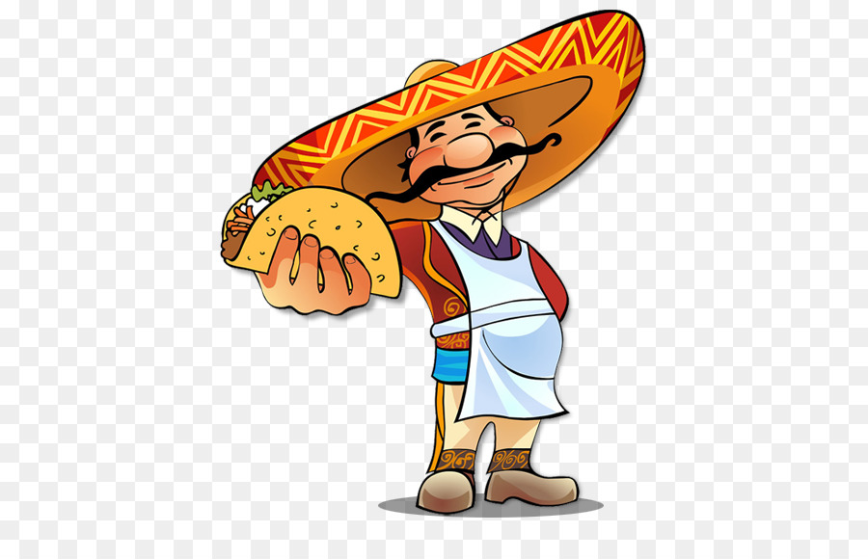
Elevator pitch
It is a taco eating challenge.
Eat as many as possible.
Available in Spanish.

Slide 3
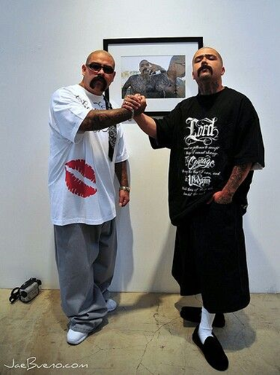
30 second gameplay description
Tacos fly at you from the sky
Try to catch them in your mouth and eat them.
Avoid barbed wire.
Lose 5 tacos, you get beat up by cholos and game over.
Get 30 tacos you win salsa power up.
Max score gets in the leaderboard

Slide 4
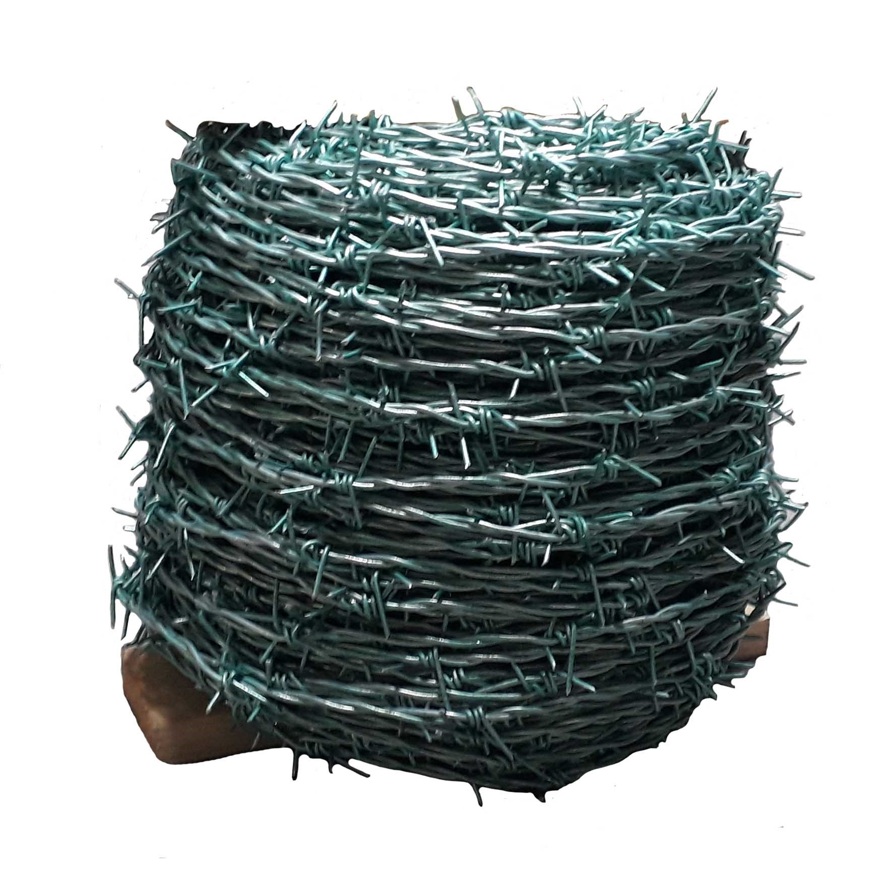

Pillars
Hand to eye coordination
Movement
Points collection.
Dodging obstacles

